Slide 1

AI-Based Job and Course Recommendation System
Leveraging TF-IDF, Machine Learning Evaluation, and Cosine Similarity Ranking to bridge the gap between skills, job roles, and educational opportunities.

Slide 2

Outline & Background
The Skills Mismatch Crisis
Gaps in Job Portals
Current job platforms fail to provide meaningful guidance about missing competencies or recommend relevant upskilling courses to candidates.
A growing disconnect exists between available skills, job role requirements, and appropriate course selection in today's dynamic employment market.
Course Platform Limitations
Educational platforms don't effectively map course content to real-time job market demands, leaving learners uncertain about their choices.

Slide 3

The Problem Space
Manual Matching Challenges
Traditional skill-to-job matching processes are subjective, time-consuming, and highly inefficient. They rely on human interpretation, leading to inconsistent outcomes and confusion for job seekers.
Without systematic guidance, individuals struggle to identify which skills they need to develop and which courses will genuinely advance their careers.
Our Aim: Build an intelligent AI system that automatically creates meaningful connections between skills, job roles, and relevant courses—eliminating guesswork and empowering informed career decisions.

Slide 4
Innovations
01
02
03
Hybrid Intelligence Architecture
Synthetic Label Generation
Multi-Model Evaluation
Automatically generates training labels from unstructured job descriptions and course content without manual annotation.
Systematic assessment of KNN, SVM, and Logistic Regression classifiers to identify optimal performance.
Combining machine learning classification with cosine similarity ranking for comprehensive recommendation accuracy.
04
05
Unified Intelligence Pipeline
Zero Manual Labelling
Seamlessly connects skills analysis through job role prediction to personalised course recommendations.
Operates independently without requiring manually labelled datasets through self-generated categorisation.

Slide 5
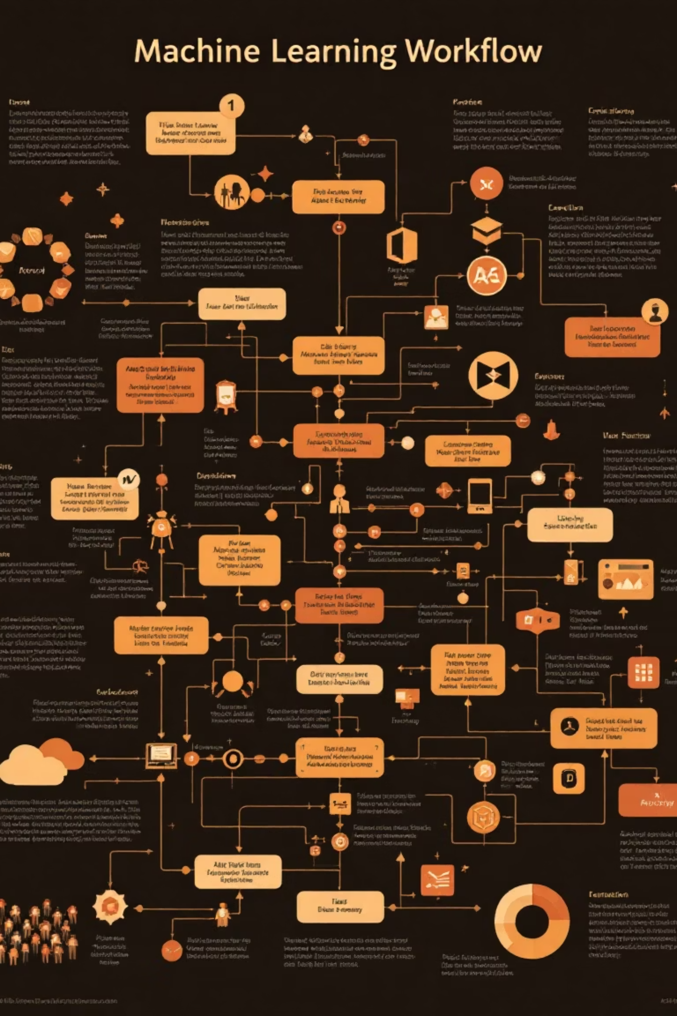



System Architecture
Data Ingestion
TF-IDF vectorisation of job descriptions and course content from Naukri and Udemy datasets.
ML Classification
Three-model comparison (KNN, SVM, Logistic Regression) for job role prediction based on skills.
Similarity Ranking
Cosine similarity algorithm ranks and recommends the most relevant courses for predicted job roles.

Slide 6
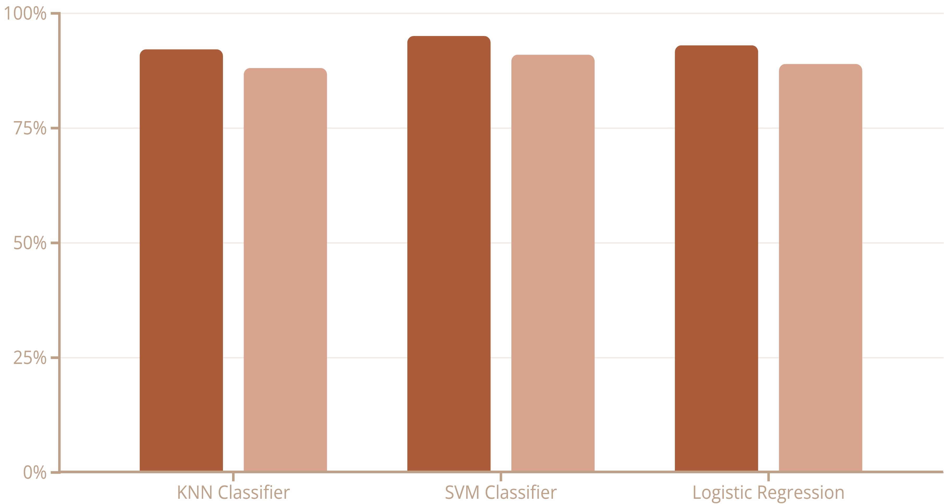
Model Performance Evaluation
Best Performer: SVM
Support Vector Machine achieved the highest accuracy on both training (95%) and testing (91%) datasets.
Comprehensive accuracy assessment across three machine learning
classifiers demonstrates strong predictive capabilities and reliable job role classification.
Consistent Clustering:
The system accurately clusters job roles and identifies relevant courses with strong precision.
Personalized Rankings:
Cosine similarity ensures individualised, ranking-based recommendations tailored to specific skill profiles.
Training Accuracy
Testing Accuracy
Best Performer: SVM
Consistent Clustering
Personalised Rankings
Support Vector Machine achieved the highest accuracy on both training (95%) and testing (91%) datasets.
The system accurately clusters job roles and identifies relevant courses with strong precision.
Cosine similarity ensures individualised, ranking-based recommendations tailored to specific skill profiles.

Slide 7

Commercial Potential & References
High Scalability
Prior Arts Referenced
The system demonstrates exceptional scalability potential and strong commercialisation opportunities across multiple sectors:
US20160232043A1Malnati, James RSkills-based recommendation system
Education technology platforms seeking intelligent course recommendations
Corporate HR departments for employee skill development
Career counselling services requiring data-driven guidance
Online learning marketplaces enhancing user experience
US20190291721A1SAKANO, Morihiko et alCourse recommendation apparatus
Acknowledgements
Institution: Lovely Professional University
Data Sources: Naukri Job Dataset (CSV), Udemy Course Dataset (CSV)
US20200345612A1LEBRETON, Pierre et alJob matching system
Technologies: pandas, numpy, scikit-learn, nltk, joblib

Slide 8

Thank You
Any Questions?

